Slide 1

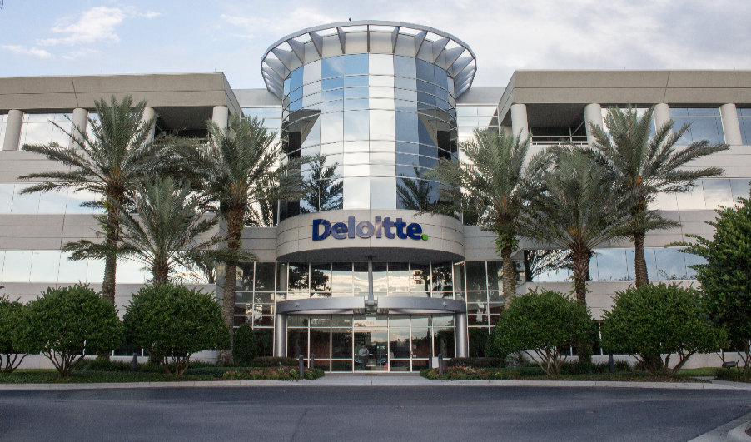
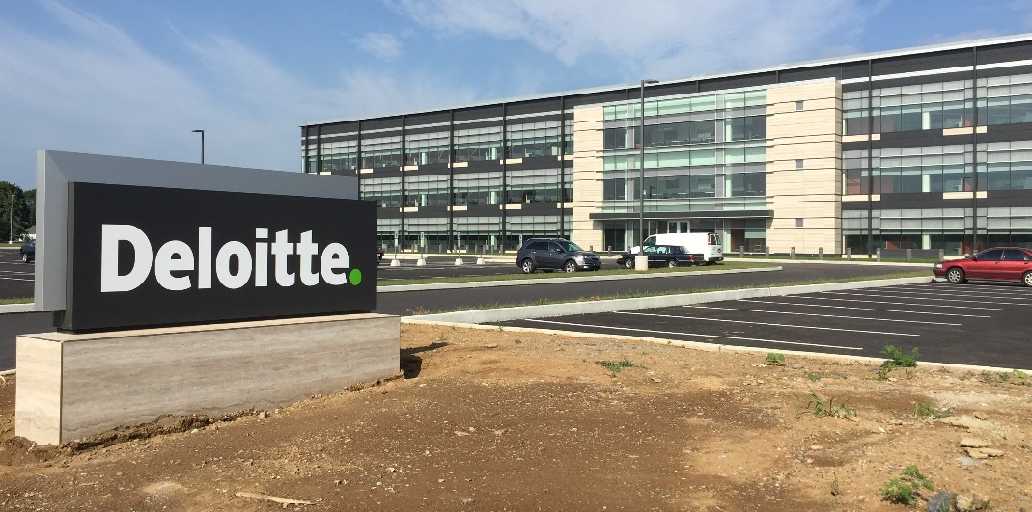
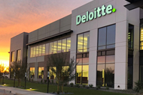
USDC Information Technology Center of Excellence (IT-CoE)
Topic: CompTIA Security+ Testing Review
Orlando, FL
Mechanicsburg, PA
Gilbert, AZ

Slide 2

USDC IT CoE: Security+ Testing Review – Session 5

Slide 3
Secure Coding
Session 5
Security+
CompTIA Security+
Test: SYO-601
EXAM OBJECTIVES (DOMAINS)
The table below lists the domains measured by this examination and the extent to which they are represented:
Session 5
Includes Objectives from Domains 1, 2, and 3
Objective 1.3 – Given a scenario, analyze potential indicators associated with application attacks.
Objective 2.1 – Explain the importance of security concepts in an enterprise environment.
Objective 2.3 – Summarize secure application development, deployment, and automation concepts.
Objective 3.2 – Given a scenario, implement host or application security solutions.
Domain | Weight
1.0 Threats, Attacks and Vulnerabilities | 24%
2.0 Architecture and Design | 21%
3.0 Implementation | 25%
4.0 Operations and Incident Response | 16%
5.0 Governance, Risk, and Compliance | 14%
Total | 100%

Slide 4
Secure Coding
Session 5
Security+
Terminology
Agile development – A method of software development meant to be rapid with short iterations.
Internet of Things (IoT) – Devices that interact on the internet, without human intervention.
Open Web Application Security Project (OWASP) – An online community that develops free articles, documentation, tools, and more on web application security.
Prototyping – Creating a version of an application that has only the bare minimum functionality so that it can be evaluated before further development.
Secure coding – Programming in a manner that is secure.
Waterfall Method – A software development method that uses very well-defined sequential phases.
Zero-day Exploit – A vulnerability that is unknown to the product vendor, and thus there is no patch for it.

Slide 5

Secure Coding
Session 5
Security+
Types of Vulnerabilities
Zero Day Exploits
This refers to a vulnerability that is found in a software product and the exploiting of that vulnerability before the software vendor can produce a patch to fix the vulnerability.
When a vulnerability to a web browser or operating system or other software product is found, the hacker community will let each other know, and it open to exploitation to the hackers in that community. The software vendor may find out days, weeks or even longer after the vulnerability is discovered.
Many vendors offer ‘bug rewards’ for information about zero-day exploits.

Slide 6
Secure Coding
Session 5
Security+
Types of Vulnerabilities
U.S. Computer Emergency Readiness Team (US-CERT)
Software vulnerabilities tracked in a publicly available database. http://web.nvd.nist.gov
When a vulnerability is discovered, it is assigned a CVE number. (Common Vulnerability or Exposure)
Vulnerability / remediation process:
Vendor releases software and code to the general public with unknown vulnerabilities.
A vulnerability is discovered, and the vendor is notified. (can be discovered by vendor or other parties)
A countermeasure or patch is created by the vendor.
The patch is released and made available to the public.
The patch is downloaded and installed on the affected systems or devices.
The period between when the vulnerability is discovered and when the patch is applied is known as the vulnerability time (Vt)
Vt = Vt open – Vt closed
Zero-Day Vulnerability – From Step 2, a vulnerability is found by someone other than the vendor and an attacker takes advantage of that vulnerability before the vendor can create a patch.

Slide 7
Secure Coding
Session 5
Security+
Types of Vulnerabilities
Secure Protocols
When networks were developed, including the internet, they were not designed for security.
Selecting secure protocols over insecure ones for network data traffic.
Insecure Secure
HTTP HTTPS
SMTP SMTPS
POP3 POP3S
IMAP IMAPS
FTP FTPS
SFTP
SCP
DNS DNSSEC
SNMP SNMPv3
LDAP LDAPS
RTP sRTP

Slide 8

Secure Coding
Session 5
Security+
Embedded Systems Security
Internet of Things (IoT)
Electronic devices that are connected to the internet with dedicated computerized functions, such as appliances, sensors, actuators, medical devices, automobiles, and factory devices.
These devices represent potential hacking opportunities with vulnerabilities that are unknown at this time.
For example: it has been reported that car computers can be hacked, and the attacker can gain control over the vehicle while it is in motion.

Slide 9
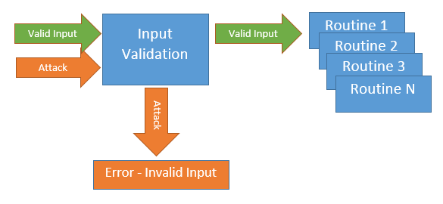
Secure Coding
Session 5
Security+
Application Vulnerabilities
Input Validation
The process of validating data entered into the web application, before the data is sent to the web application for processing.
A first line of defense for application coding.
Application Sandboxing
The process of writing files to a sandbox or temporary storage area instead of their normal location. This limits the ability of execution of code on a user’s computer.

Slide 10
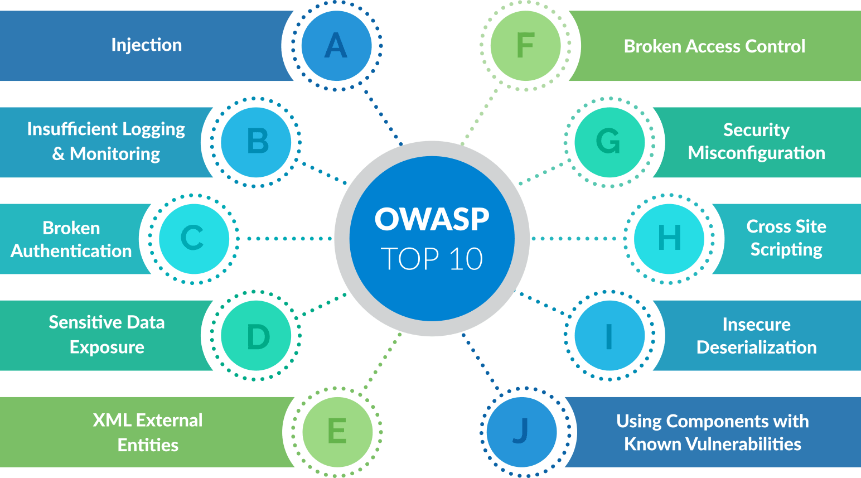
Secure Coding
Session 5
Security+
Secure Programming
OWASP
Open Web Application Security Project
Standards, frameworks, and guidelines for the development of web applications.
https://www.owasp.org/
Tracks and maintains Top 10 list of application security vulnerabilities.

Slide 11
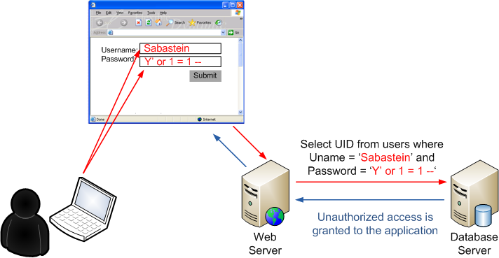
Secure Coding
Session 5
Security+
Application Vulnerabilities
SQL Injection Attack
The process of sending malicious SQL queries to the underlying database to manipulate the database, exfiltration of data. SQL probing when the attacker uses the single quote (‘) symbol.
A Web Application Firewall can test for these characters in the incoming url.

Slide 12
Secure Coding
Session 5
Security+
Application Vulnerabilities
Improper Error Handling
Error handling and reporting should not report back on the website ‘too much’ information when an error is encountered that would provide details of the web server for a potential attacker.
Session Management Attacks
Session Token prediction.
Session Token sniffing and tampering.
User closes the browser but does not log out. Session is still active and can be used to reopen the site.
Clickjacking
Disguising the URL that is being clicked on a page from a recognizable URL to a hidden URL.

Slide 13
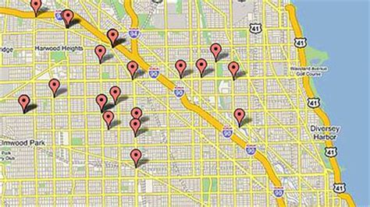
Secure Coding
Session 5
Security+
Application Vulnerabilities
Geotagging
Normally ‘on’ for most mobile smartphones or tablets, this feature geotags exact location and timestamps when photos are taken.
Security concern is the availability of this information to track an individual's movements.
A geotag is the longitude, latitude, and time stamp of when the photo was taken.

Slide 14
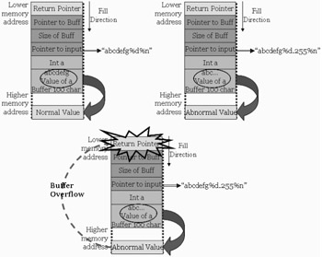
Secure Coding
Session 5
Security+
Application Vulnerabilities
Buffer Overflow
Data written to a buffer exceeds the limit of the buffer size.
Programs should do buffer size error checking.
Buffer overflows can crash the system or allow hacker to execute malicious code.

Slide 15
Secure Coding
Session 5
Security+
Application Vulnerabilities
Memory Leaks
Common programming error … when an application does not free up memory that was allocated to run the program, after the program has completed.
Could cause the system to slow down, freeze up and crash.
Resource Exhaustion
Denial of Service attack that exhausts all resources necessary to execute an application.
Integer Overflow or Wraparound
Attempting to store a number that is larger that the data type assigned to that variable.
Improper programming of this type can cause unknown abnormal behavior.

Slide 16
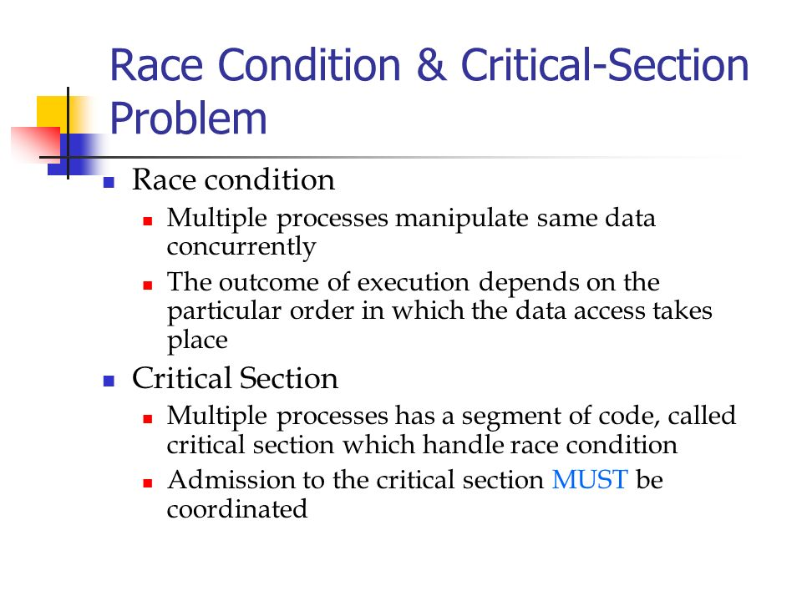
Secure Coding
Session 5
Security+
Application Vulnerabilities
Race Conditions (TOC/TOU)
Exploits the delay between the Time of Check (TOC) and the Time of Use (TOU).
Attacker is racing to make a change to the object after it is stored and before the system uses it. Application should use exclusive-lock resources.

Slide 17
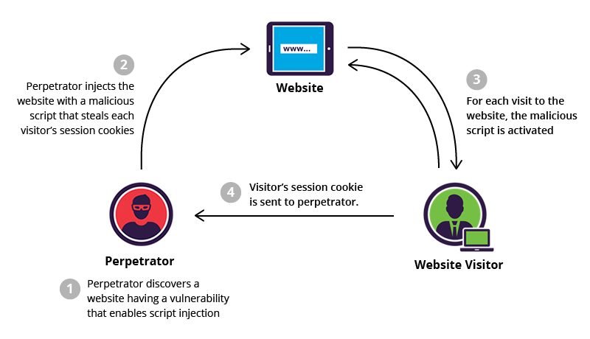
Secure Coding
Session 5
Security+
Application Vulnerabilities
Cross-Site Scripting (XSS)
Exploitation of a vulnerability on a website to inject malicious code into a web application.
Using client-side scripting languages such as JavaScript without proper input or output validation on dynamic websites.
Keyword in the malicious script code is “</script>”
Nonpersistent XSS – URL with rogue script.
Persistent XSS – Websites that allow users to input data that is stored in a database or other location.
DOM (Document Object Model) based XSS – local document attacked to modify original page client-side JavaScript.
Example:
Index.php?name=<script>window.onload=function(){var link=document.getElements➔ByTagName(“a”);link[0].href=http://not-real-xssattackexamples.com/;}</script>

Slide 18
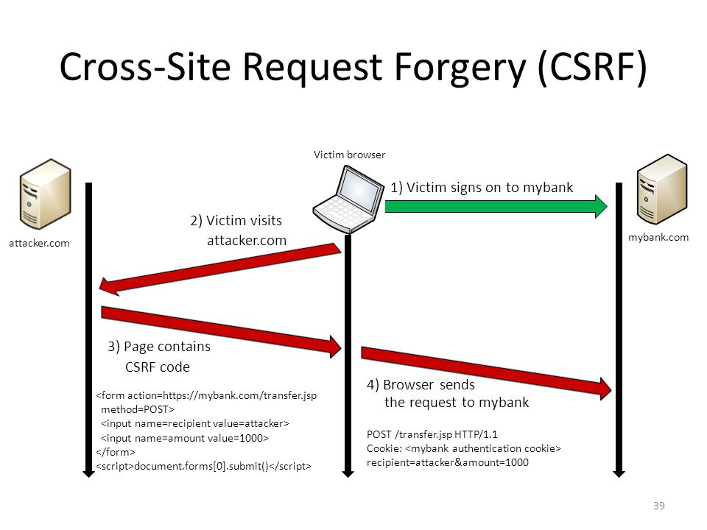
Secure Coding
Session 5
Security+
Application Vulnerabilities
Cross-Site Request Forgery (CSRF)
Tricks a browser to send a forged HTTP request, including cookies and authentication tokens, to a vulnerable web application.
Known as a one-click attack or session-riding, malicious command are transmitted by a user that the web application trusts.

Slide 19
Secure Coding
Security+
Session 5
Types of Vulnerabilities
Knowledge Check 2
An attacker discovers a new vulnerability in an enterprise application. The attacker takes advantage of the vulnerability by developing new malware.
After installing the malware, the attacker is provided with access to the infected machine.
Which of the following is being described?
A. Zero-day exploit
B. Remote code execution
C. Session hijacking
D. Command injection

Slide 20
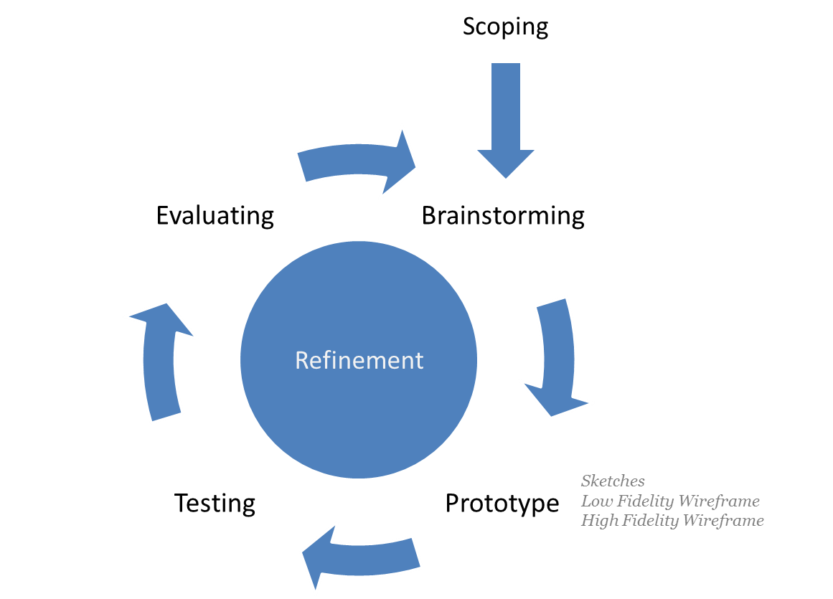
Secure Coding
Session 5
Security+
Secure Programming
Prototyping
Creating prototypes of software applications under design and development.
Prototypes give a visual representation of the developers understanding of the requested application. This representation is reviewed by the end user to receive valuable feedback early in the development cycle.
Prototypes can also be used to provide insight into the accuracy of initial project estimates, deadlines, and milestones.
Wireframes are the visual representation of prototypes.

Slide 21
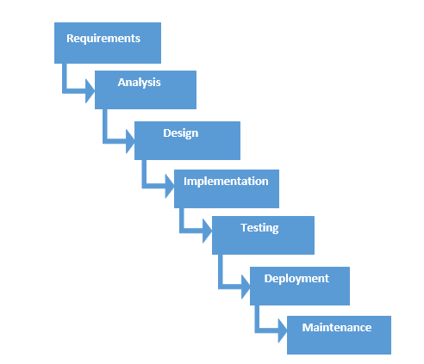
Secure Coding
Session 5
Security+
Secure Programming
Programming Models
Waterfall Model – This development model utilizes the pattern steps of software development from requirements gathering to implementation of the finished product, with development progress being contingent upon the completion of each step before moving to the next step.
Software Development Steps
Requirements Gathering
Design
Coding
Testing
Deployment
Maintenance

Slide 22
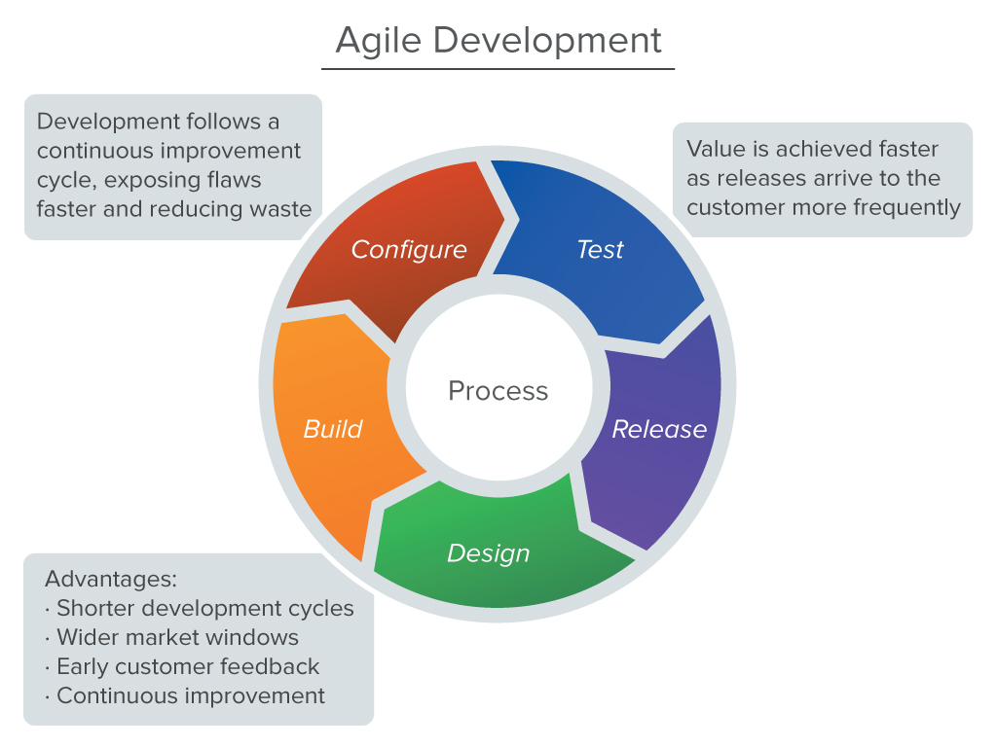
Secure Coding
Session 5
Security+
Secure Programming
Programming Models
Agile Model – This development model works in cycles with specific deliverables of the finished application delivered in a cycle. With this model, the software development steps are repeated each cycle for each deliverable produced in the cycle.
The benefits of this model is the ability for rapid changes in the final product that are adaptable to end users needs and requirements.
This flexible adaptive approach to software development is becoming the norm.

Slide 23
Secure Coding
Session 5
Security+
Application Vulnerabilities
Testing Types
White box testing – all of the details of the inner workings of the application are known during testing.
Gray box testing – Some but not all of the details of the inner workings of the application is known during testing.
Black box testing – None of the details of the application is known before testing. Testers can only test the input and output of the application.
Regression testing – full testing cycle of the application after a change is made.
Unit testing – done by the developers during development.
Function testing – Validates the program against a set of functional requirements.

Slide 24
Secure Coding
Security+
Session 5
Secure Programming
Knowledge Check 3
A development team has adopted a new approach to projects in which feedback is iterative and multiple iterations of deployments are provided within an application’s full life cycle.
Which of the following software development methodologies is the development team using?
A. Waterfall
B. Agile
C. Rapid
D. Extreme

Slide 25
Secure Coding
Session 5
Security+
Secure Programming
Standard Libraries without security controls.
C++ libraries
Functions that can be exploited because they don’t check for proper buffer size:
strcat()
strcpy()
sprint()
vsprintf()
bcopy()
scanf()

Slide 26
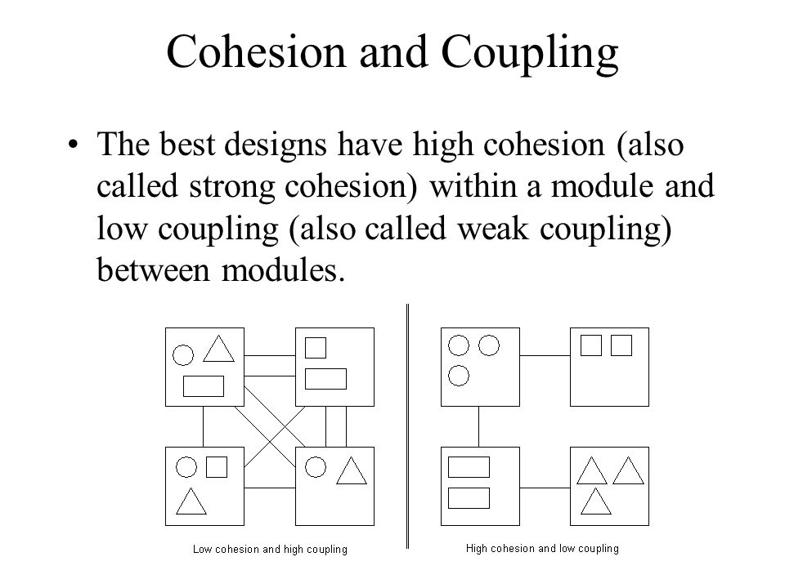
Secure Coding
Session 5
Security+
Secure Programming
Secure Coding Standards and Practices
In-line code SQL queries not allowed.
All SQL queries done by Stored Procedure
Minimize entry and exit points in the code
Verify all input values
Minimize code interdependence
Modules developed with high cohesion and low coupling
Cohesion – a module can perform a single task with little input from other modules.
Coupling – the measurement of the interconnectivity between code modules.

Slide 27
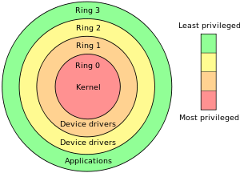
Secure Coding
Session 5
Security+
Secure Programming
Privilege Escalation
When the code of the application runs at a higher permission privilege than the user that is running the application.
The Rings of Protection model provides protection to different levels of the system where code is allowed to execute.
The outer rings have less privilege, and the inner rings have the most privilege to execute code within the system.

Slide 28
Secure Coding
Session 5
Security+
Secure Programming
Improper Storage of Sensitive Data
Protect sensitive data with isolation and encryption.
Encrypt PII, in separate databases.
Don’t allow direct object references in the URL access to data in application code.
Protection of Cookie Data
Cookies are uses to maintain web application session state.
Cookies contain important information about the user, web sites accessed, and input data for the web sites.
Cookies are stored on the users computer and can be accessed at rest or in transit if not encrypted.

Slide 29
Secure Coding
Session 5
Security+
Secure Programming
Javascript/Applets
A cross-platform programming language that runs in the browser on the client side.
Particularly vulnerable to Cross-Site Scripting (XSS) and Cross-Site Request Forgery (CSRF)
Web Services Security
Developed by OASIS as an extension to SOAP to route SOAP messages through more secure protocols such as HTTPS, Kerberos, and X.509 certificates.

Slide 30
Secure Coding
Session 5
Security+
Thank You!!
Send questions and slide deck requests to:
Jim Reeves
Security+, CASP+,CySA+, CISSP, ITILv3, CTT+
MCSE, MCSD, MCT
jireeves@Deloitte.com

